Slide 1


http://www.comp.nus.edu.sg/~cs2100/
Lecture #2c
Overview of C Programming

Slide 2
Questions?
Ask at https://sets.netlify.app/module/66988ae3322ba68d1103fdd4
OR
Scan and ask your questions here! (May be obscured in some slides)

Slide 3
6. Selection Structures (1/2)
C provides two control structures that allow you to select a group of statements to be executed or skipped when certain conditions are met.
if … else …
if (condition) {
/* Execute these statements if TRUE */
}
if condition:
# Statement
if condition:
# Statement
elif condition:
# Statement
else:
# Statement
if (condition) {
/* Execute these statements if TRUE */
}
else {
/* Execute these statements if FALSE */
}

Slide 4
6. Selection Structures (2/2)
switch
Python
No counterpart
/* variable or expression must be of discrete type */
switch ( <variable or expression> ) {
case value1:
Code to execute if <variable or expr> == value1
break;
case value2:
Code to execute if <variable or expr> == value2
break;
...
default:
Code to execute if <variable or expr> does not
equal to the value of any of the cases above
break;
}

Slide 5
6.1 Condition and Relational Operators
A condition is an expression evaluated to true or false.
It is composed of expressions combined with relational operators.
Examples: (a <= 10), (count > max), (value != -9)
Relational Operator | Interpretation
< | is less than
<= | is less than or equal to
> | is greater than
>= | is greater than or equal to
== | is equal to
!= | is not equal to
Python
Allows
1 <= x <= 5

Slide 6
6.2 Truth Values
Python
NOTE: only integers!
In Python and JavaScript you have truthy and falsy values, but not in C
Boolean values: true or false.
There is no Boolean type in ANSI C. Instead, we use integers:
0 to represent false
Any other value to represent true (1 is used as the representative value for true in output)
Example:
TruthValues.c
int a = (2 > 3);
int b = (3 > 2);
printf("a = %d; b = %d\n", a, b);
a = 0; b = 1

Slide 7
6.3 Logical Operators
Complex condition: combining two or more Boolean expressions.
Examples:
If temperature is greater than 40C or blood pressure is greater than 200, go to A&E immediately.
If all the three subject scores (English, Maths and Science) are greater than 85 and mother tongue score is at least 80, recommend taking Higher Mother Tongue.
Logical operators are needed: && (and), || (or), ! (not).
A | B | A && B | A || B | !A
False | False | False | False | True
False | True | False | True | True
True | False | False | True | False
True | True | True | True | False
Python
A || B → A or B
A && B → A and B
!A → not A

Slide 8
6.4 Evaluation of Boolean Expressions (1/2)
The evaluation of a Boolean expression is done according to the precedence and associativity of the operators.
Operator Type | Operator | Associativity
Primary expression operators | ( ) [ ] . -> expr++ expr-- | Left to Right
Unary operators | * & + - ! ~ ++expr --expr (typecast) sizeof | Right to Left
Binary operators | * / % | Left to Right
 | + -
 | < > <= >=
 | == !=
 | &&
 | ||
Ternary operator | ?: | Right to Left
Assignment operators | = += -= *= /= %= | Right to Left
Python
cond ? expr1 : expr2 →
expr1 if cond else cond2

Slide 9
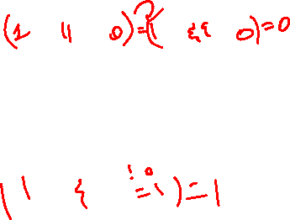
6.4 Evaluation of Boolean Expressions (2/2)
What is the value of x?
int x, y, z,
a = 4, b = -2, c = 0;
x = (a > b || b > c && a == b);
x is true (1)
gcc issues warning (why?)
Always good to add parentheses for readability.
y = ((a > b || b > c) && a == b);
y is false (0)
What is the value of z?
z = ((a > b) && !(b > c));
z is true (1)
Try out EvalBoolean.c

Slide 10
6.5 Short-Circuit Evaluation
Does the following code give an error if variable a is zero?
if ((a != 0) && (b/a > 3)) {
printf(. . .);
}
Short-circuit evaluation
expr1 || expr2: If expr1 is true, skip evaluating expr2 and return true immediately, as the result will always be true.
expr1 && expr2: If expr1 is false, skip evaluating expr2 and return false immediately, as the result will always be false.

Slide 11
7. Repetition Structures (1/2)
C provides three control structures that allow you to select a group of statements to be executed repeatedly.
while ( condition )
{
// loop body
}
do
{
// loop body
} while ( condition );
for ( initialization; condition; update )
{
// loop body
}
Update: change value of loop variable
Initialization: initialize the loop variable
Condition: repeat loop while the condition on loop variable is true

Slide 12
7. Repetition Structures (2/2)
Example: Summing from 1 through 10.
Sum1To10_DoWhile.py
Sum1To10_While.py
Sum1To10_DoWhile.c
Sum1To10_While.c
sum, i = 0, 1
sum = sum + i
i = i + 1
while i <= 10:
sum = sum + i
i = i + 1
sum,i = 0, 1
while i <= 10:
sum = sum + i
i = i + 1
int sum = 0, i = 1;
do {
sum = sum + i;
i++;
}
while (i <= 10);
int sum = 0, i = 1;
while (i <= 10) {
sum = sum + i;
i++;
}
Sum1To10_For.py
Sum1To10_For.c
sum = 0
for i in range(1, 11):
sum = sum + i
int sum, i;
for (sum = 0, i = 1; i <= 10; i++) {
sum = sum + i;
}

Slide 13
7.1 Using ‘break’ in a loop (1/2)
BreakInLoop.py
BreakInLoop.c
Without 'break':
1
Ya
2
Ya
3
Ya
4
Ya
5
Ya
# without 'break'
print("Without 'break':");
for i in range(1,6):
print(i)
print("Ya")
// without 'break'
printf ("Without 'break':\n");
for (i=1; i<=5; i++) {
printf("%d\n", i);
printf("Ya\n");
}
# with 'break'
print("With 'break':");
for i in range(1,6):
print(i)
if i == 3:
break
print("Ya")
}
// with 'break'
printf ("With 'break':\n");
for (i=1; i<=5; i++) {
printf("%d\n", i);
if (i==3)
break;
printf("Ya\n");
}
With 'break':
1
Ya
2
Ya
3

Slide 14
7.1 Using ‘break’ in a loop (2/2)
With 'break’ in …
1, 1
Ya
1, 2
Ya
1, 3
2, 1
Ya
2, 2
Ya
2, 3
3, 1
Ya
3, 2
Ya
3, 3
BreakInLoop.py
BreakInLoop.c
# with 'break' in a nested loop
print("With 'break' in a nested loop:")
for i in range(1,4):
for j in range(1,6):
print(i, ",", j)
if j == 3:
break;
print("Ya")
// with 'break' in a nested loop
printf("With 'break' in a nested loop:\n");
for (i=1; i<=3; i++) {
for (j=1; j<=5; j++) {
printf("%d, %d\n", i, j);
if (j==3)
break;
printf("Ya\n");
}
}
In a nested loop, break only breaks out of the inner-most loop that contains the break statement.

Slide 15
7.2 Using ‘continue’ in a loop (1/2)
Without 'continue':
1
Ya
2
Ya
3
Ya
4
Ya
5
Ya
ContinueInLoop.py
ContinueInLoop.c
# without 'continue'
print("Without 'continue':")
for i in range(1,6):
print(i)
print("Ya")
// without 'continue'
printf ("Without 'continue':\n");
for (i=1; i<=5; i++) {
printf("%d\n", i);
printf("Ya\n");
}
# with 'continue'
print("With 'continue':")
for i in range(1,6):
print(i)
if i == 3:
continue
print("Ya")
// with 'continue'
printf ("With 'continue':\n");
for (i=1; i<=5; i++) {
printf("%d\n", i);
if (i==3)
continue;
printf("Ya\n");
}
With 'continue':
1
Ya
2
Ya
3
4
Ya
5
Ya

Slide 16
7.2 Using ‘continue’ in a loop (2/2)
With ...
1, 1
Ya
1, 2
Ya
1, 3
1, 4
Ya
1, 5
Ya
2, 1
Ya
2, 2
Ya
2, 3
2, 4
Ya
2, 5
Ya
ContinueInLoop.py
ContinueInLoop.c
# with 'continue' in a nested loop
print("With 'continue' in a nested loop:")
for i in range(1,4):
for j in range(1,6):
print(i, ",", j)
if j == 3:
continue
print("Ya")
// with 'continue' in a nested loop
printf("With 'continue' in a nested loop:\n");
for (i=1; i<=3; i++) {
for (j=1; j<=5; j++) {
printf("%d, %d\n", i, j);
if (j==3)
continue;
printf("Ya\n");
}
}
3, 1
Ya
3, 2
Ya
3, 3
3, 4
Ya
3, 5
Ya
In a nested loop, continue only skips to the next iteration of the inner-most loop that contains the continue statement.

Slide 17
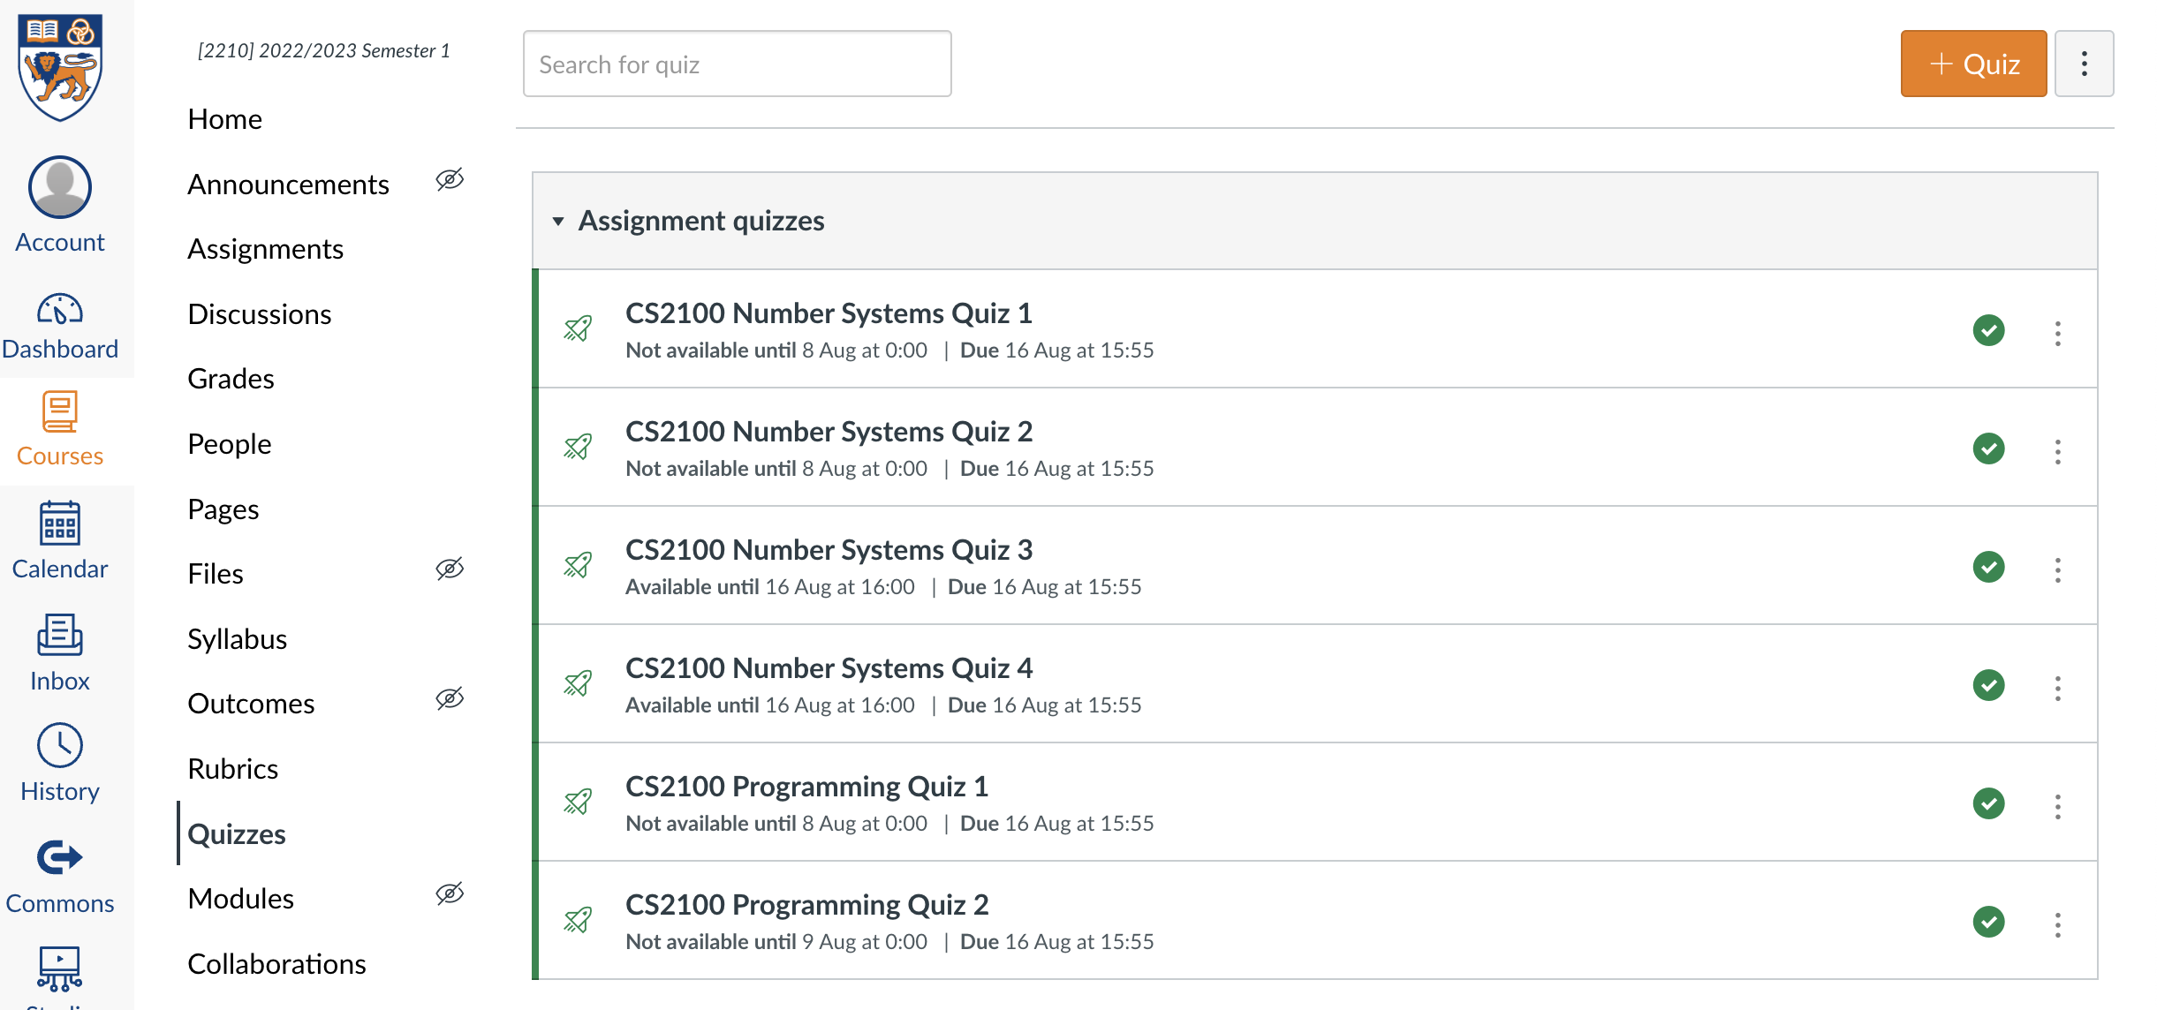
Quiz
Please complete the “CS2100 C Programming Quiz 2” in Canvas.
Access via the “Quizzes” tool in the left toolbar and select the quiz on the right side of the screen.

Slide 18
End of File

